Slide 1
2025 RPD Poster Template Guidelines
Fill out information in top header area:
Poster Title
Your name, section number, and your postdoc job title (see list below)
  If you are a JPL postdoc employee, please use job title: JPL Postdoctoral Fellow
  If you are an NPP Fellow, please use job title: NASA Postdoctoral Fellow
  If you are a Visiting postdoc, please use job title: Visiting Postdoctoral Scholar
  If you are a JIFRESSE postdoc, please use job title: JIFRESSE/UCLA Postdoc
Your section number
Your advisor’s name and other collaborators and their section numbers
NOTE: Do not change the header (green) color as it is meant to highlight the postdoc posters during the event.
Content Area:
Be mindful of the judging criteria:
Original research contribution
  Does the poster clearly explain the postdoc’s individual contribution to the research? Specifically, where the postdoc’s research fits within the framework of the larger team project.
  Does the research contain novel concepts, theoretical frameworks, methods, or devices?
  Does the presenter's research offer the potential to introduce novel contribution or advancements to the field?
Communication
  Does the poster clearly convey the research's motivation and its alignment with broader JPL/NASA objectives? For example: What are the long-term goals of this work? If this research is successful, what JPL-relevant science/technology does this work enable?
  Does the poster outline a comprehensive plan for sharing this research with the wider community beyond JPL? Is there a clear strategy to showcase the work's significance?
  Is the poster succinct, yet comprehensive, designed to cater to an audience with varying levels of expertise? Can an individual from a different discipline easily comprehend the content?
Clarity of presentation
  Are the components of the poster organized in a logical flow, guiding the reader from background information to the research's significance?
  Are the components of the poster balanced across the poster, ensuring an even representation of components without overwhelming or underrepresenting any section?
Footer Area:
Gray Box to the right:
Add publications relevant to the work being presented. If no publications yet, indicate manuscripts in prep or submitted.
Add your contact information
To the left:
Add your Poster Number (refer to the list from the Postdoc Office, or to email received upon signing up (sent from Smartsheet, check your spam folder))
NOTE: Do not remove the copyright and NASA/JPL notations.

Slide 2

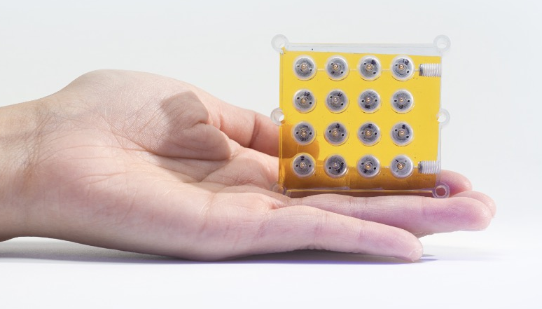
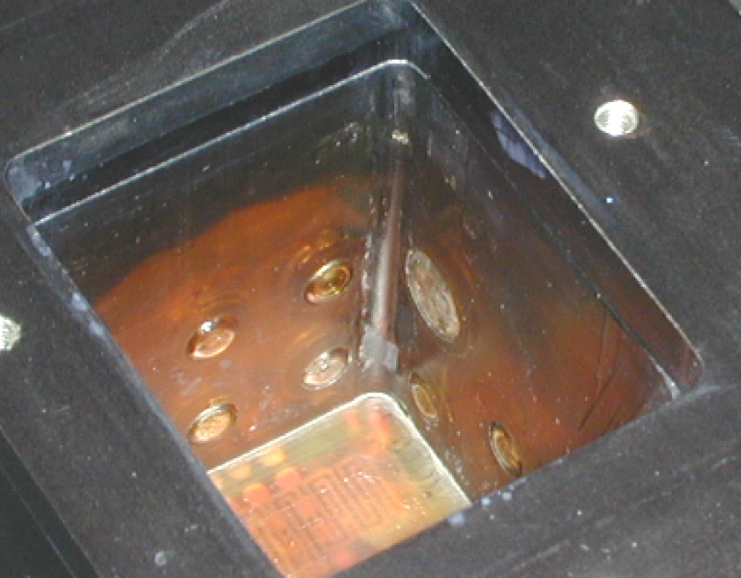
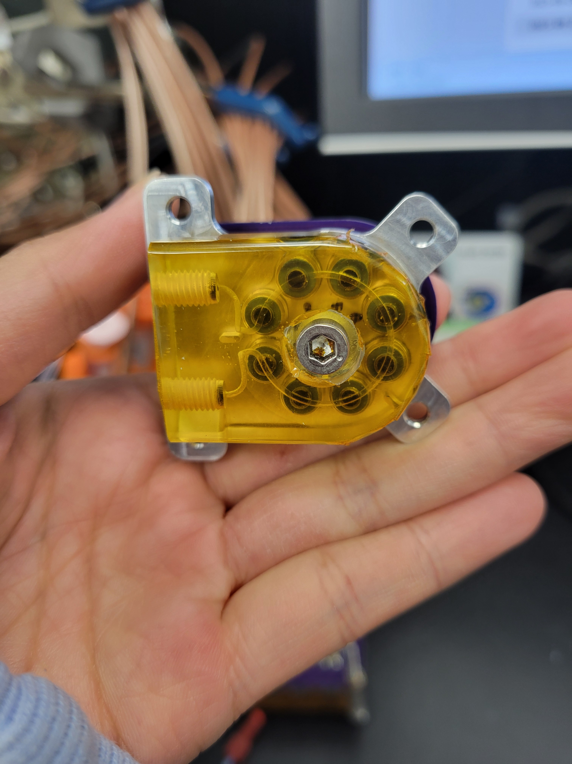
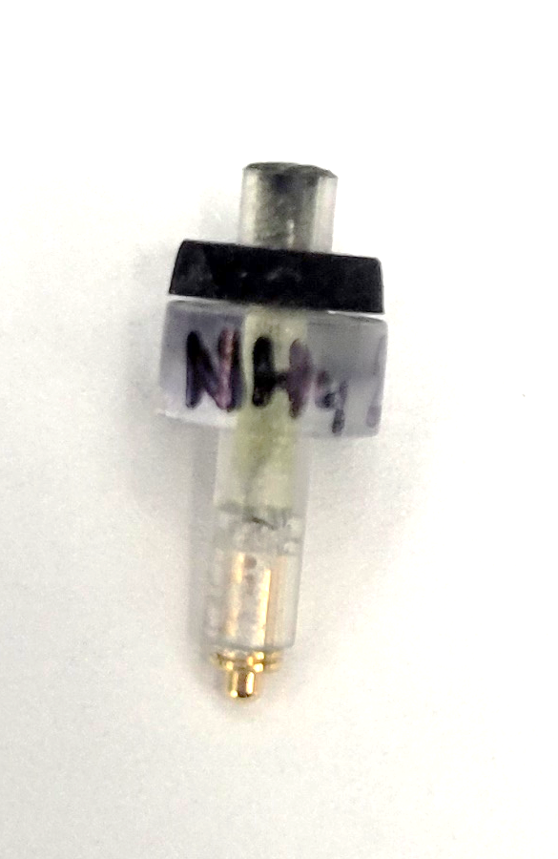
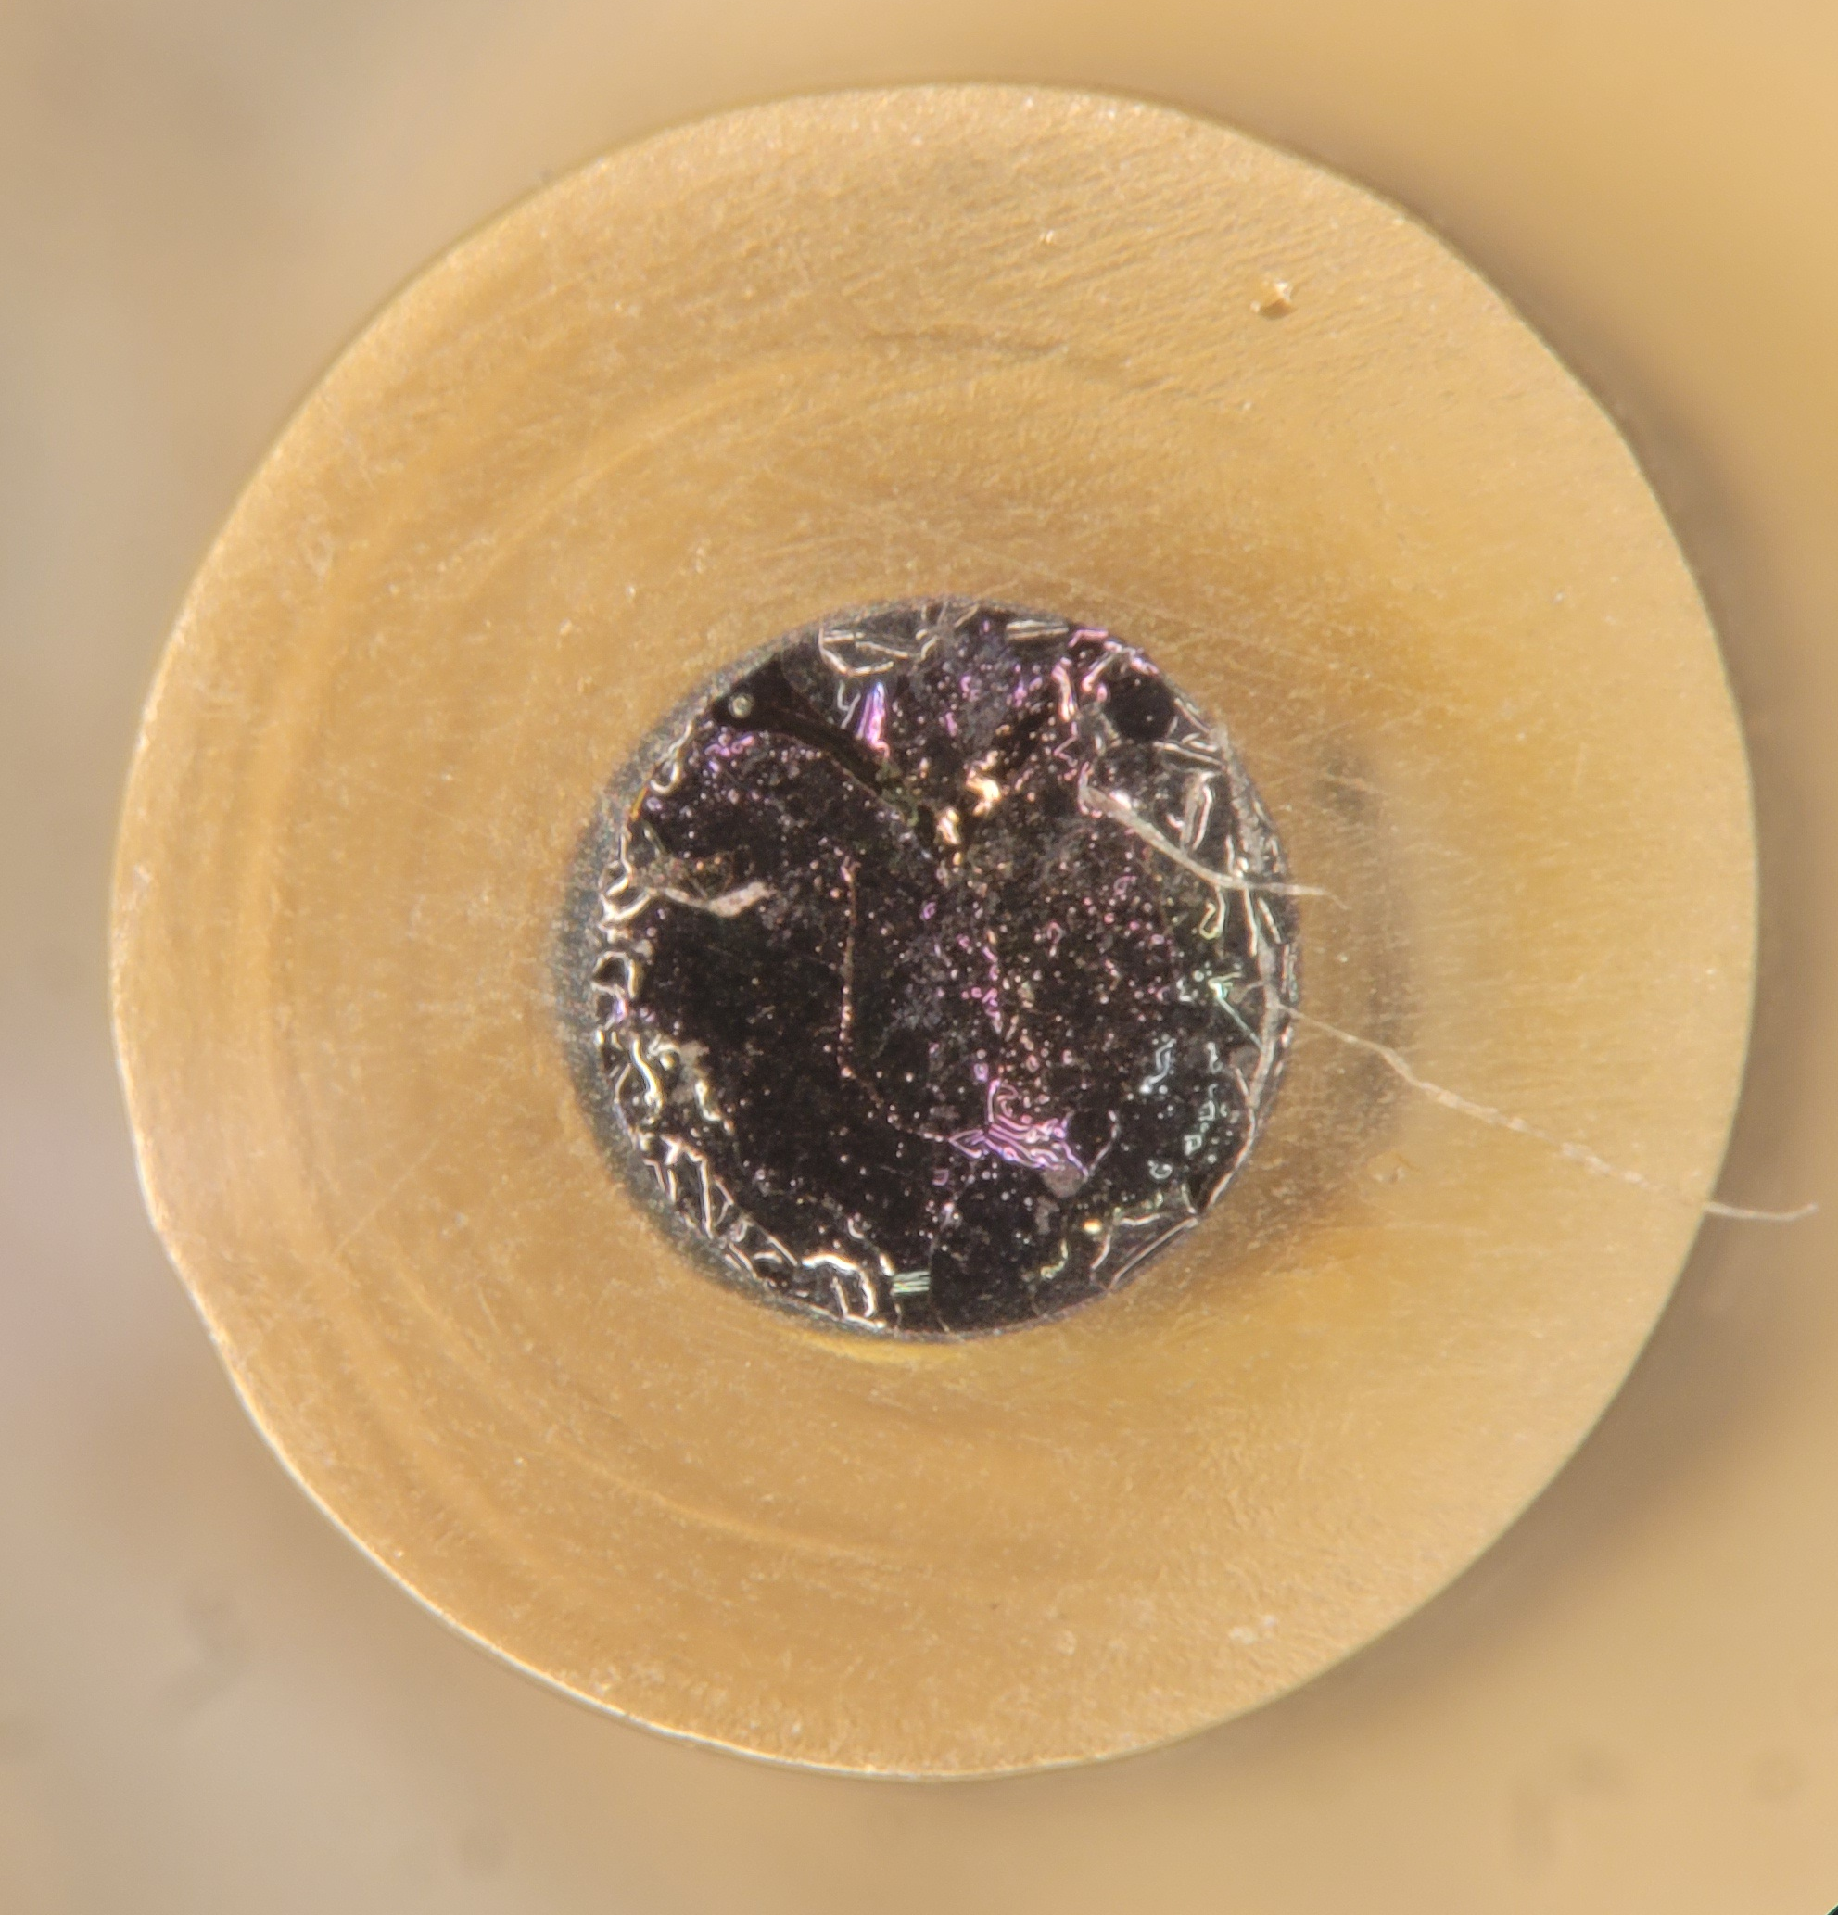
National Aeronautics and Space Administration
Postdoc Research
Electrochemical Sensor Arrays
for Habitability and Water Monitoring
Author: Michelle Tran (389U, JPL Postdoctoral Fellow)
Co authors: Aaron C. Noell (389U), Elizabeth A. Jaramillo and Andrew B. Berg (355Z)
Background
The identification and measurement of inorganic ions in water samples is a critical step in planetary science measurements and water quality monitoring for human space flight.
This work builds upon the demonstrated success of ion selective electrodes (ISEs) which were an integral part of the Phoenix Mars Lander’s Wet Chemistry Lab (WCL). ISEs were utilized to make in situ measurements of inorganics on Mars.
Figure 1. NASA Phoenix Mars Lander Wet Chemistry Laboratory (WCL) beaker with embedded ion selective electrodes. The beaker could hold 25 mL of leaching solution.
Image credit: NASA/JPL
Ion Selective Electrodes (ISEs)
Electrochemical sensor – Converts chemical information into a measurable electrical signal.
Selective to specific ions.
Carbon Nanomaterial
(Transducer layer)
Ion Selective Membrane
Figure 2. Components of an ion selective electrode (ISE). An ion selective membrane and carbon nanomaterial transduction layer is deposited onto an electrically conductive glassy carbon rod.
Glassy carbon
Objectives of ISE arrays
Minimize the volume needed to make electrochemical measurements.
Establish operations to make simultaneous measurements of multiple target ions.
Demonstrate long-term stability of ISEs.
Approach and Results
Volume reduction to ~30 µL was achieved through miniaturization of ISEs and integration into a fluidic manifold, forming an array of ISEs.
Figure 3. Miniaturized ISE and an array of 6 ISEs in a fluidic manifold. Sample is flowed across the surface of the ISEs pneumatically, enabling chemical measurements.
Each ion selective electrode in the array is responsible for identifying a specific inorganic ion.
NH₄⁺, Li⁺, K⁺ and Na⁺ were simultaneously evaluated in mixed ion samples using the array of ISEs.
Conditioning the sensors with a mixed ion solution was found to be integral to sensor performance.
The performance of ammonium ISEs were monitored over 1 year and exhibited performance within ±20% of the ideal response.
Figure 5. Response of ISEs to a mixed ion standards. A Nernstian response of
59 mV/decade indicates the sensors were working properly.
+59 mV
Figure 4. Selectivity of an ammonium ISE when exposed to varying ion solutions. The ISE shows consistent and greater selectivity toward the target NH₄⁺ ion than other species.
Significance of Results
This work has established robust electrochemical sensors which has the capability to evaluate inorganics in small-volume water samples.
This work is in the process of being integrated into the Space Water Impurity Monitor which monitors water quality for human use in Space.
Figure 6. Changes in slope response for an ammonium ISE over the course of 1 year.
Future directions
Expanding the array of ISEs to evaluate more target ions relevant to planetary science and human safety.
Integrating conductivity and pH sensors into the array.
Figure 7. pH sensitive iridium oxide layer deposited onto a glassy carbon electrode.
National Aeronautics and Space Administration
Jet Propulsion Laboratory
California Institute of Technology
Pasadena, California
www.nasa.gov
Clearance Number: CL#00-0000
Poster Number: Postdoc-T-02
Copyright 2024. All rights reserved.
Acknowledgements:
The authors would like to acknowledge Anthony Morales-Badajoz (389U) and Jake Lee (398J) for their assistance.
Author Contact Information:
Email: michelle.tran@jpl.nasa.gov

